Slide 1
Double-Ended Queues
CS 22 Data Structures and Algorithms
6.3

Slide 2
Double-Ended Queues
Double-ended Queue, aka Deque (pronounced “deck”)
More general than either stacks or queues
Add or delete from either front or back of queue
Could function as either stack or a queue

Slide 3
Double-Ended Queues
Add to Front
Add to End
3
1
4
5
9
2
Remove from Front
Remove from End

Slide 4
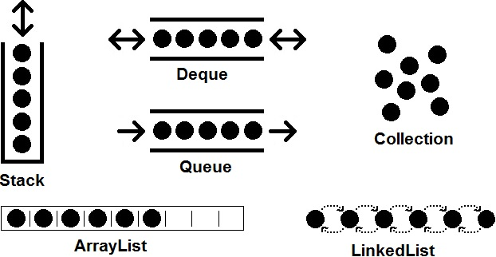
Double-Ended Queues
This Photo by Unknown Author is licensed under CC BY-SA

Slide 5
The Dequeue Abstract Type
Update methods:
addFirst(e): | Insert a new element e at the front of the deque.
addLast(e): | Insert a new element e at the back of the deque.
removeFirst(): | Remove and return the first element of the deque (or null if the deque is empty).
removeLast(): | Remove and return the last element of the deque (or null if the deque is empty).

Slide 6
The Dequeue Abstract Type
Accessor methods:
first(): | Returns the first element of the deque, without removing it (or null if the deque is empty).
last(): | Returns the last element of the deque, without removing it (or null if the deque is empty).
size(): | Returns the number of elements in the deque.
isEmpty(): | Returns a boolean indicating whether the deque is empty.

Slide 7
The Dequeue Abstract Type

Slide 8
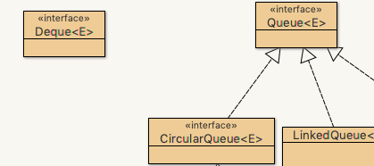
Deque Interface
Open up DSAJ-sourcecode with BlueJ
find package net.datastructures
open
file Deque.java

Slide 9
Implementing a Deque
6.3.2

Slide 10
Implementing a Deque
Implement a deque with a circular array
Like an ArrayQueue
Keep the index of the first element
Keep the current size of the deque
Delete front element, f = (f + 1) % N
Insert at front, f = (f - 1 + N) % N
Q
0
1
2
f
r

Slide 11
Implementing a Deque
Implement a deque with a doubly-linked list
DoublyLinkedList.java class already fulfills this function
Just add “implements Deque<E>” to the class definition

Slide 12
Performance of Deque Operations
Deque implemented either as array or DLL
Method | Running Time
size, isEmpty | O(1)
first, last | O(1)
addFirst, addLast | O(1)
removeFirst, removeLast | O(1)

Slide 13
6.3.3 Deques in the Java Collection Framework

